Slide 1
DYSCIPHER
Using Optical Character Recogniser (OCR) to predict Text
-By Team Gigatessaract (NIT TRICHY)

Slide 2
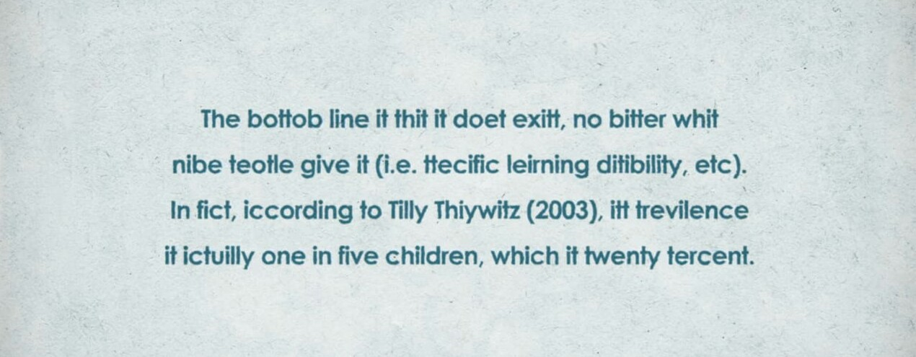

Slide 3
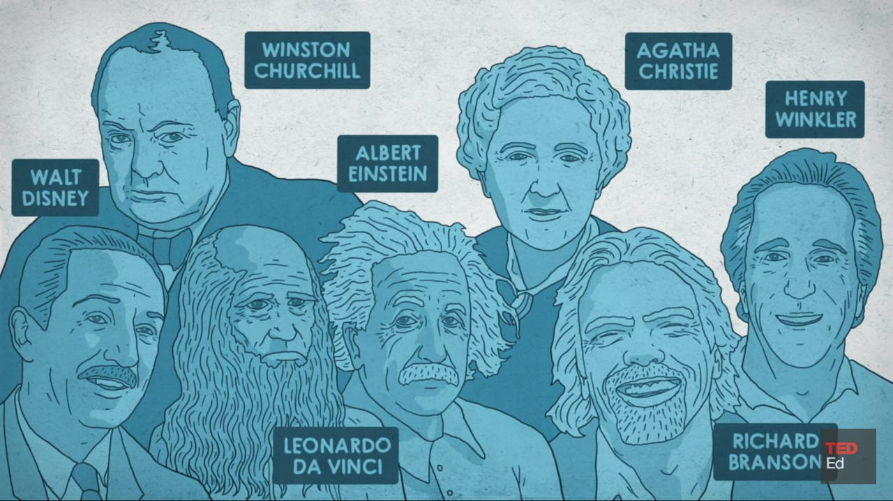

Slide 4
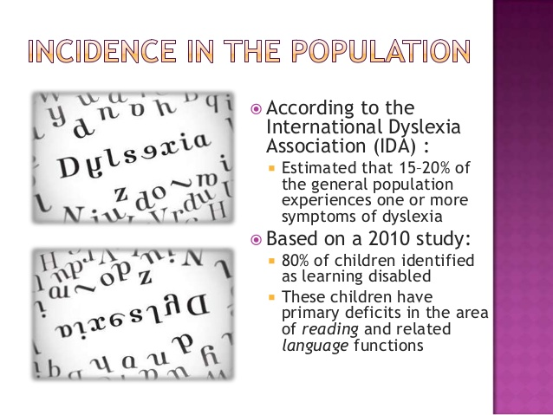

Slide 5
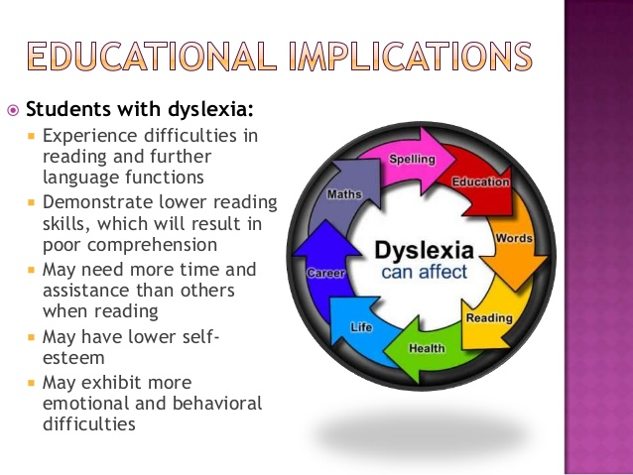

Slide 6
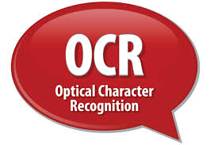
OUR SOLUTION
Our solution does not strive to change the way dyslexic kids see and communicate with the world, but how we can try and understand what they perceive. We plan on implementing an Optical Character Recogniser, (OCR) that can take text written by dyslexic child as input and converts it into comprehensible output. This will solve the problem of existing communication gap by keeping both the dyslexic person and the other interlocutor in their comfort zones.

Slide 7
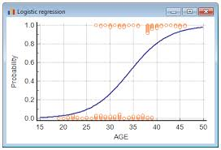
HOW DO WE ACHIEVE THIS:
Writing is one of their main disability. A progressive solution to help them would be to use assistive technology.
A software which recognises the handwritten text of an individual with dyslexia and uses machine learning algorithms to try and make meaningful sentences from the perceived words.
LOGISTIC REGRESSION

Slide 8
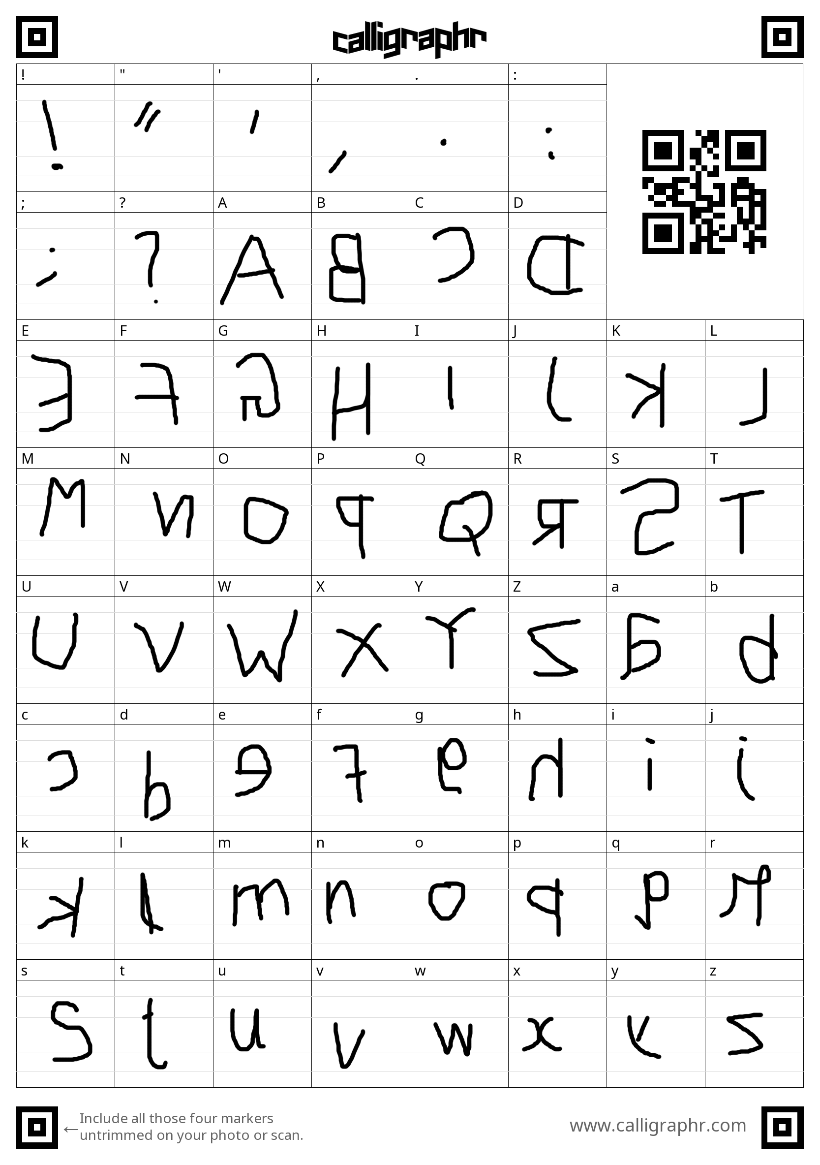
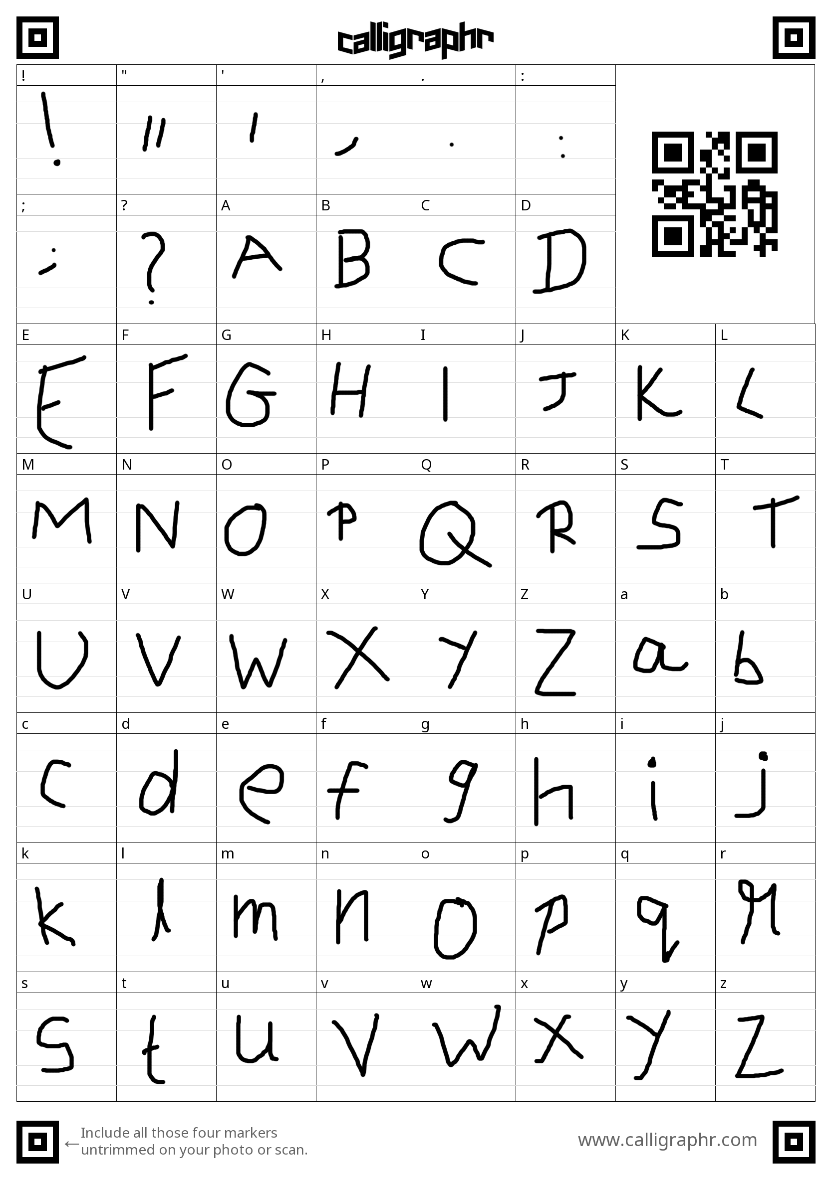
USING ML & LOGISTIC REGRESSION:
→→

Slide 9
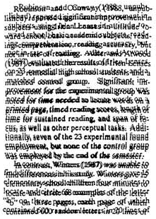
We can let the person with the disorder write down what he wants to, scan the written text using either a phone camera or a webcam.
The image is fed into the database, uses machine learning algorithms to try and make meaningful sentences from the perceived words.
WHAT DYSLEXICS SEE

Slide 10


DYSLEXIE FONT:

Slide 11
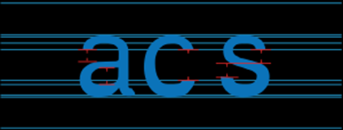
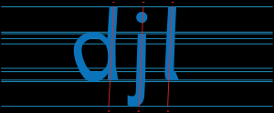

Slide 12
OTHER FEATURES:
An application that lets them connect to other dyslexic people they can relate to. This will help them to feel comfortable to express their views without any doubt of mistake. Hence, over a period of time, they'll lose their fear.
Immediate group of consulting specialists if they ever feel depressed. This will be a sort of counseling for them to help them come overcome their fears.
Further the depression rate can be calculated based on the type of words they use in chat.

Slide 13
FUTURE PLANS:
After the hackathon is over, we plan to take this idea a step further by developing an integrated kit for dyslexic people, where more features will be implemented such as a software that filters noises making sure that they can concentrate more in class, giving them the all needed special attention

Slide 14
CONSTRAINTS AND KNOWN ISSUES:
The quality of the picture relies heavily on the camera.
Getting 100% accuracy with a machine learning model is very ideal.

